Slide 1
Financial Feasibility Analysis
Presented by:
Farah Chammam
Khalil Khammassi
Ahmed Guellouz
Linda Souissi

Slide 2
01
02
TABLE OF CONTENTS
03
04
Project Description
Initial Investment & Financing Scheme
Cash Flow Statements
The Profitability of Each Case Scenario

Slide 3
Project Description
01

Slide 4
OUR COMPANY
MERCURY
Mercury is the closest planet to the Sun and the smallest one in the Solar System

Slide 5
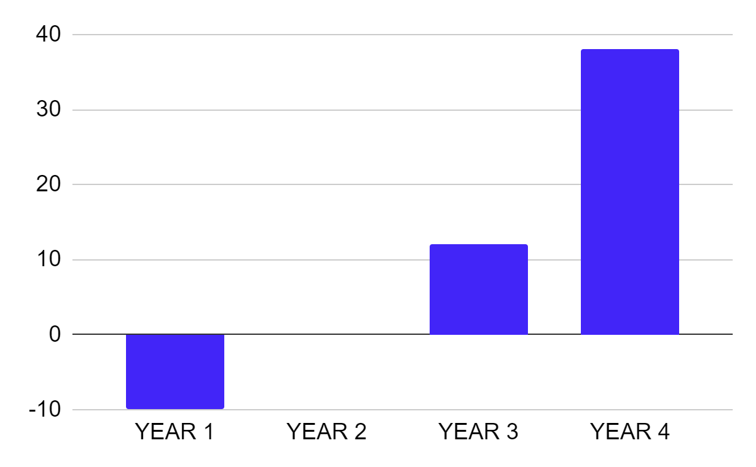
PROJECT CASH FLOW
+15%
Mercury is the smallest planet
+37
Jupiter is the biggest planet
To modify this graph, click on it, follow the link, change the data and paste the new graph here

Slide 6
Initial Investment
02
& Financing Scheme

Slide 7

Our Assets
Land: 140,000 tnd Salvage value at the end of project life: annual growth rate 4%
Building: 150,000 tnd salvage value 100,000tnd annual dep rate 5%
Transportation equipments: 74,000 tnd salvage value at the end of the project dep rate 20%
Industrial equipments: 5,000 tnd salvage value at the end of the project 2,000 tnd annual dep rate 10%
Office equipment: 10,000 tnd Salvage value at the end of project life: 5,000dt – Annual dep.rate of 20%
Software and patent: 15,000 tnd No salvage value at the end of project life – Annual dep.rate of 20%

Slide 8
Additional Information
Quantity
sold during 1st year
Unit Price
150 units
4000 TND
Variable Cost
Fixed Cost
30% of unit price
160,000 TND

Slide 9
Initial Investment
Sales= 150*4,000= 600,000tnd
Net working capital ( 60 working days) = 600,000 ( 60/360)
=100,000 tnd
I0=140,000+150,000+74,000+5,000+10,000+ 15,000+100,000
= 494,000tnd

Slide 10
Financing
Equity 60% :
394,000* 0,6= 236,400
Debt 40% :
394,000 * 0.4 = 157,600
Before tax cost of debt:
12%

Slide 11
Cash Flow Statement
03

Slide 12
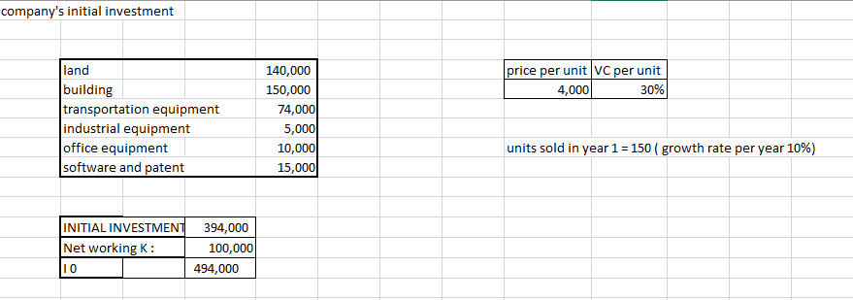
The Company’s Initial Investment

Slide 13
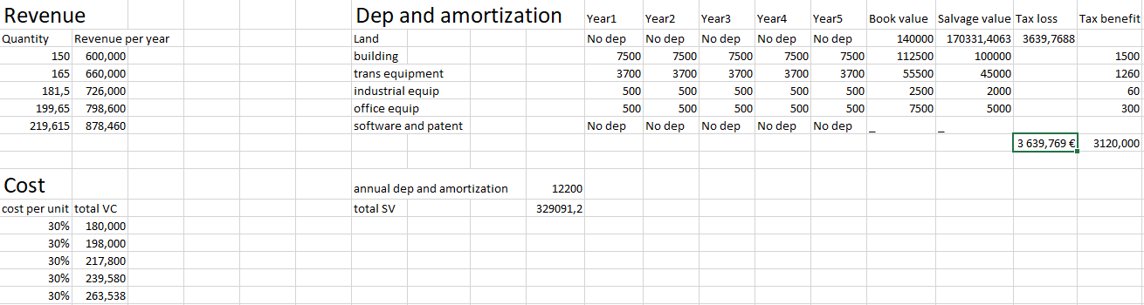
Cash Flow

Slide 14
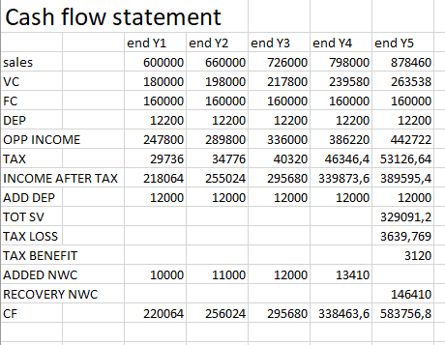

Slide 15
Profitability of each case scenario
04

Slide 16
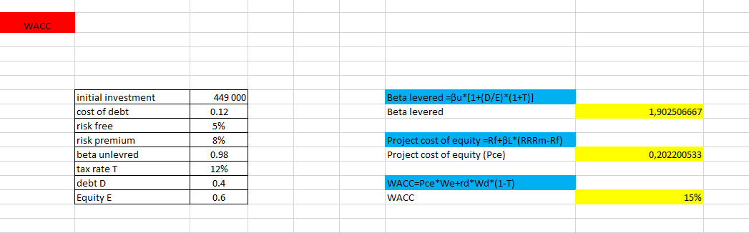
Calculation of WACC

Slide 17
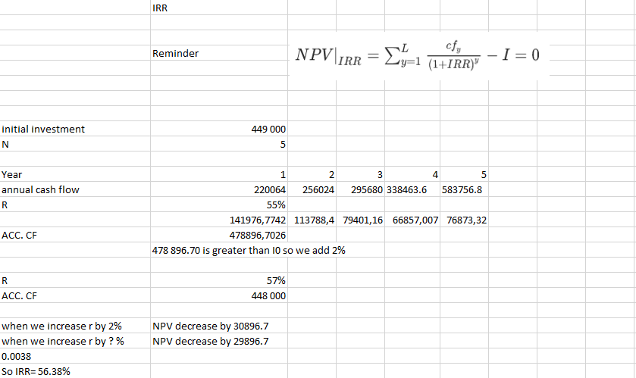
IRR

Slide 18
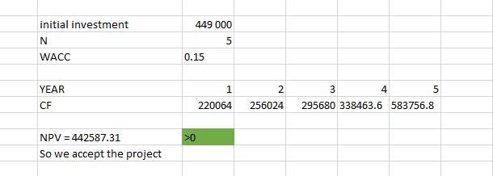
NPV
VENUS
20%
MARS
53%
10%
NEPTUNE
17%
MERCURY

Slide 19
Regular Payback Period

Slide 20
Discounted Payback Period

Slide 21
Profitability Index

Slide 23
Thank you for your attention!

